Slide 1
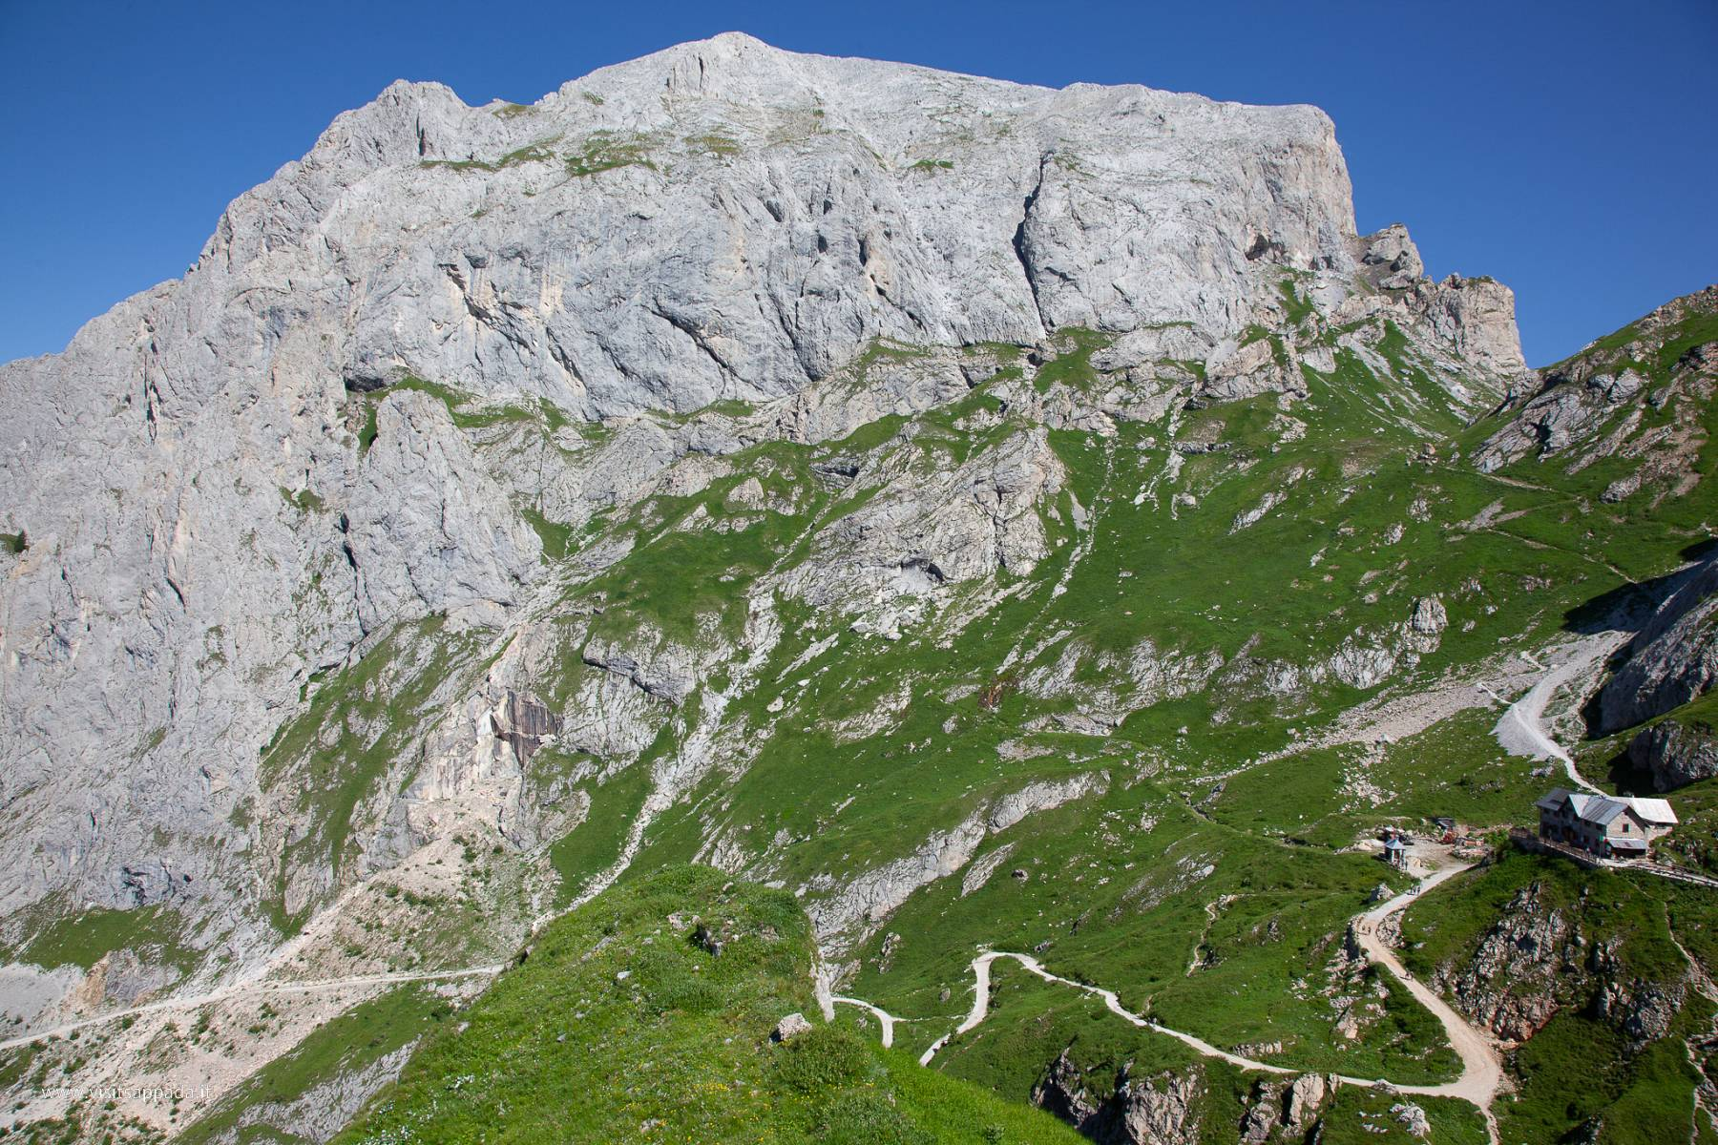




Heatwaves reshape alpine grasslands: integrating trait-based ecology and remote sensing across calcareous and siliceous systems
Arianna Del Pino¹, Enrico Braidot¹, Michele Carbognani³, T’ai G.W. Forte³, Alessandro Petraglia³, Marco Vuerich¹⁻², Marco Zancani¹, Francesco Boscutti¹⁻²
1
2
3
8th European Congress of Conservation Biology (ECCB)
6th-10th July 2026, Leiden

Slide 2






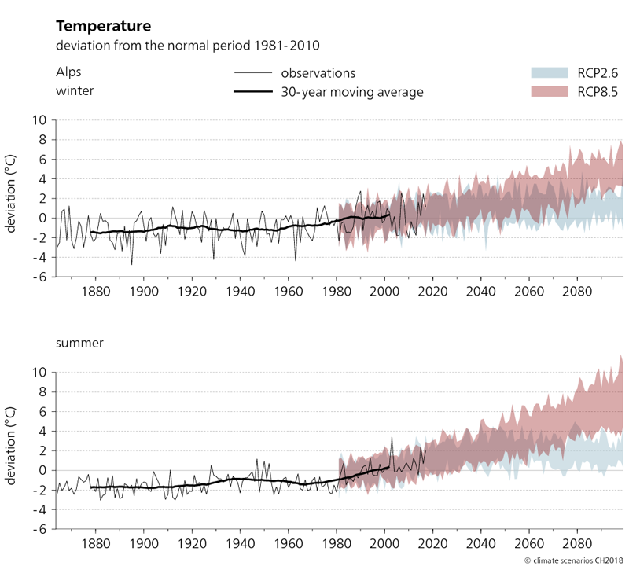
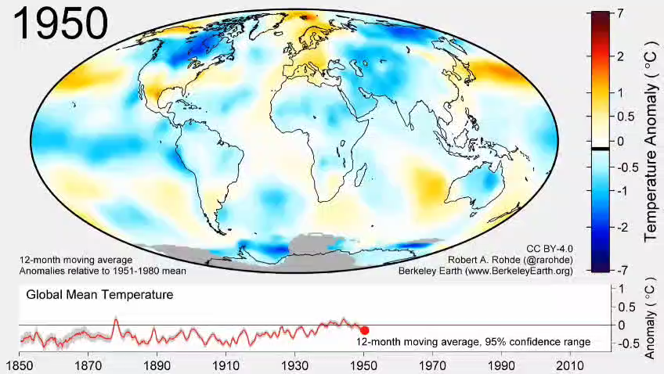
CLIMATE CHANGE
In the Alps
In the World
2021 Global Temperature Changes Since 1850
Climate Change Scenarios CH2018 Alps – National Centre for Climate Services NCCS - 2018
8th European Congress of Conservation Biology (ECCB)

Slide 3
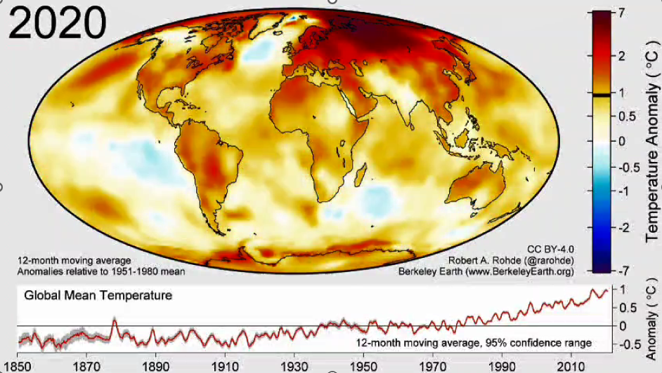
CLIMATE CHANGE
In the Alps
In the World
2021 Global Temperature Changes Since 1850
Climate Change Scenarios CH2018 Alps – National Centre for Climate Services NCCS - 2018
8th European Congress of Conservation Biology (ECCB)

Slide 4

ALPINE GRASSLANDS
ECOSYSTEM | ENVIRONMENTAL CONDITIONS | WARMING | RESPONSES
Alpine Grasslands | Short growing season Harsh climates | + 2°C | Greening Extended growing seasons Biodiversity changes
8th European Congress of Conservation Biology (ECCB)

Slide 5
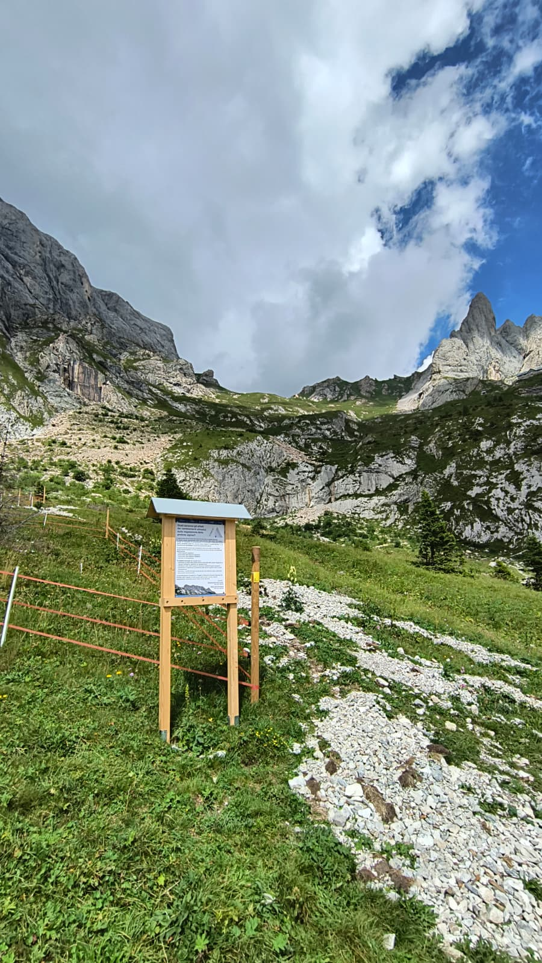
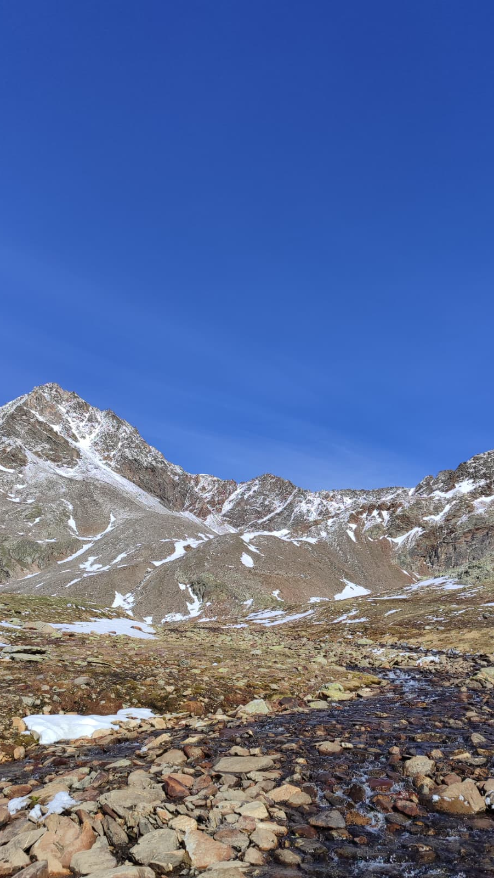
AIM OF THR PROJECT
Simulate heatwaves in alpine grasslands
Experimental questions
How do target species and biodiversity respond to heatwaves?
Is there a difference between prolonged, early or late heatwaves
Is the use of drones effective for monitoring the effects on a larger scale?
Calcareous soil
(Sappada)
Siliceous soil
(Gavia Pass)
8th European Congress of Conservation Biology (ECCB)

Slide 6
AIM OF THR PROJECT
Simulate heatwaves in alpine grasslands
Experimental questions
How do target species and biodiversity respond to heatwaves?
Is there a difference between prolonged, early or late heatwaves
Is the use of drones effective for monitoring the effects on a larger scale?
Calcareous soil
(Sappada)
Siliceous soil
(Gavia Pass)
8th European Congress of Conservation Biology (ECCB)

Slide 7
AIM OF THR PROJECT
Simulate heatwaves in alpine grasslands
Experimental questions
How do target species and biodiversity respond to heatwaves?
Is there a difference between prolonged, early or late heatwaves
Is the use of drones effective for monitoring the effects on a larger scale?
Calcareous soil
(Sappada)
Siliceous soil
(Gavia Pass)
8th European Congress of Conservation Biology (ECCB)

Slide 8
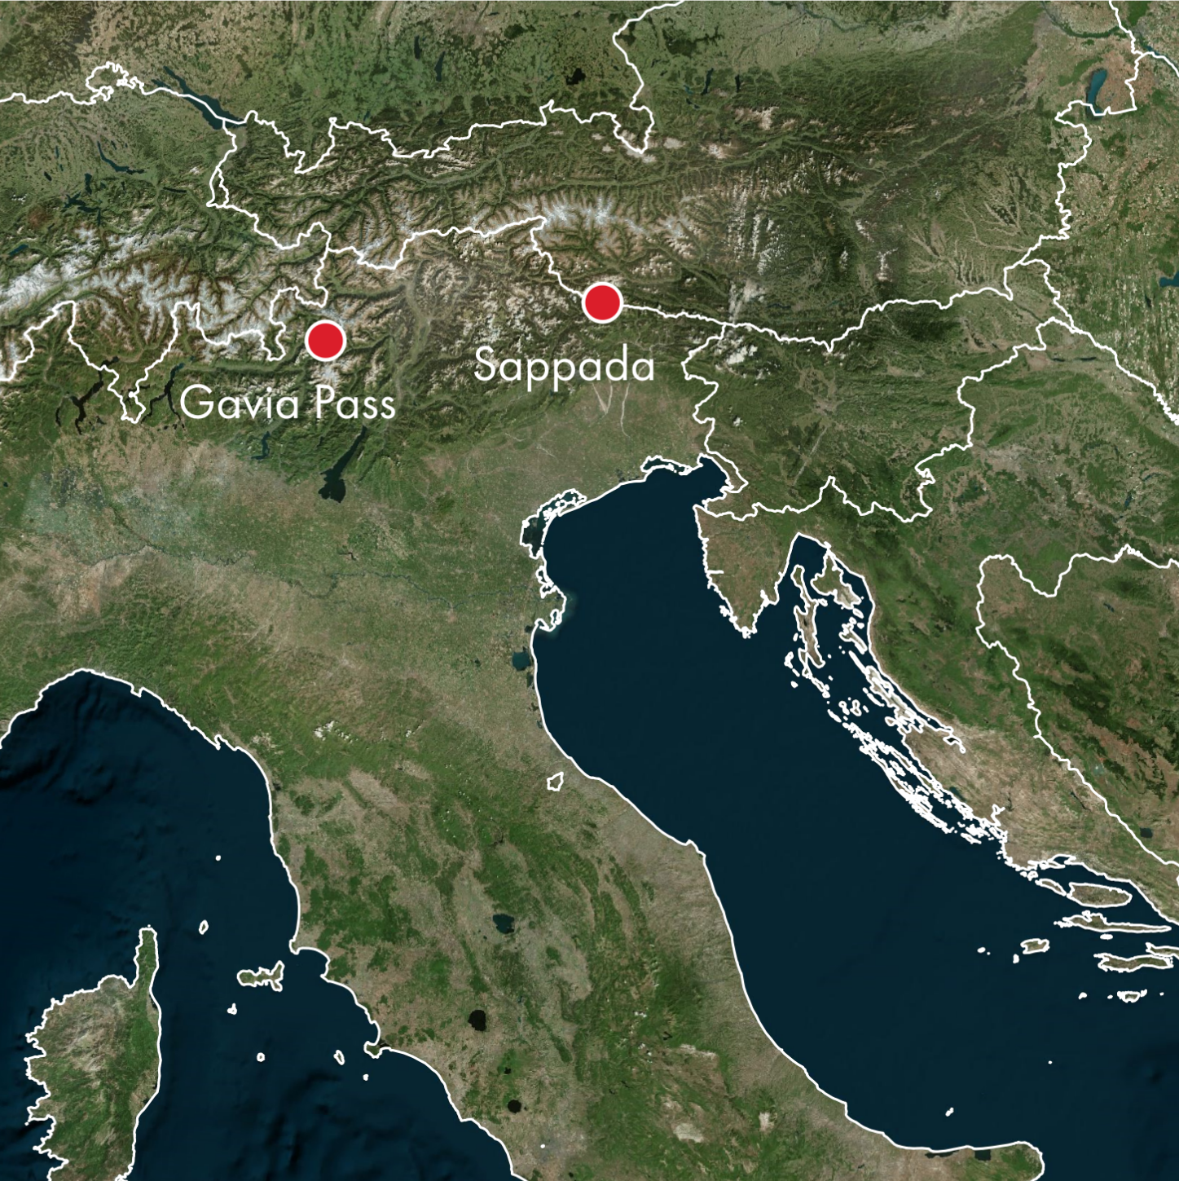
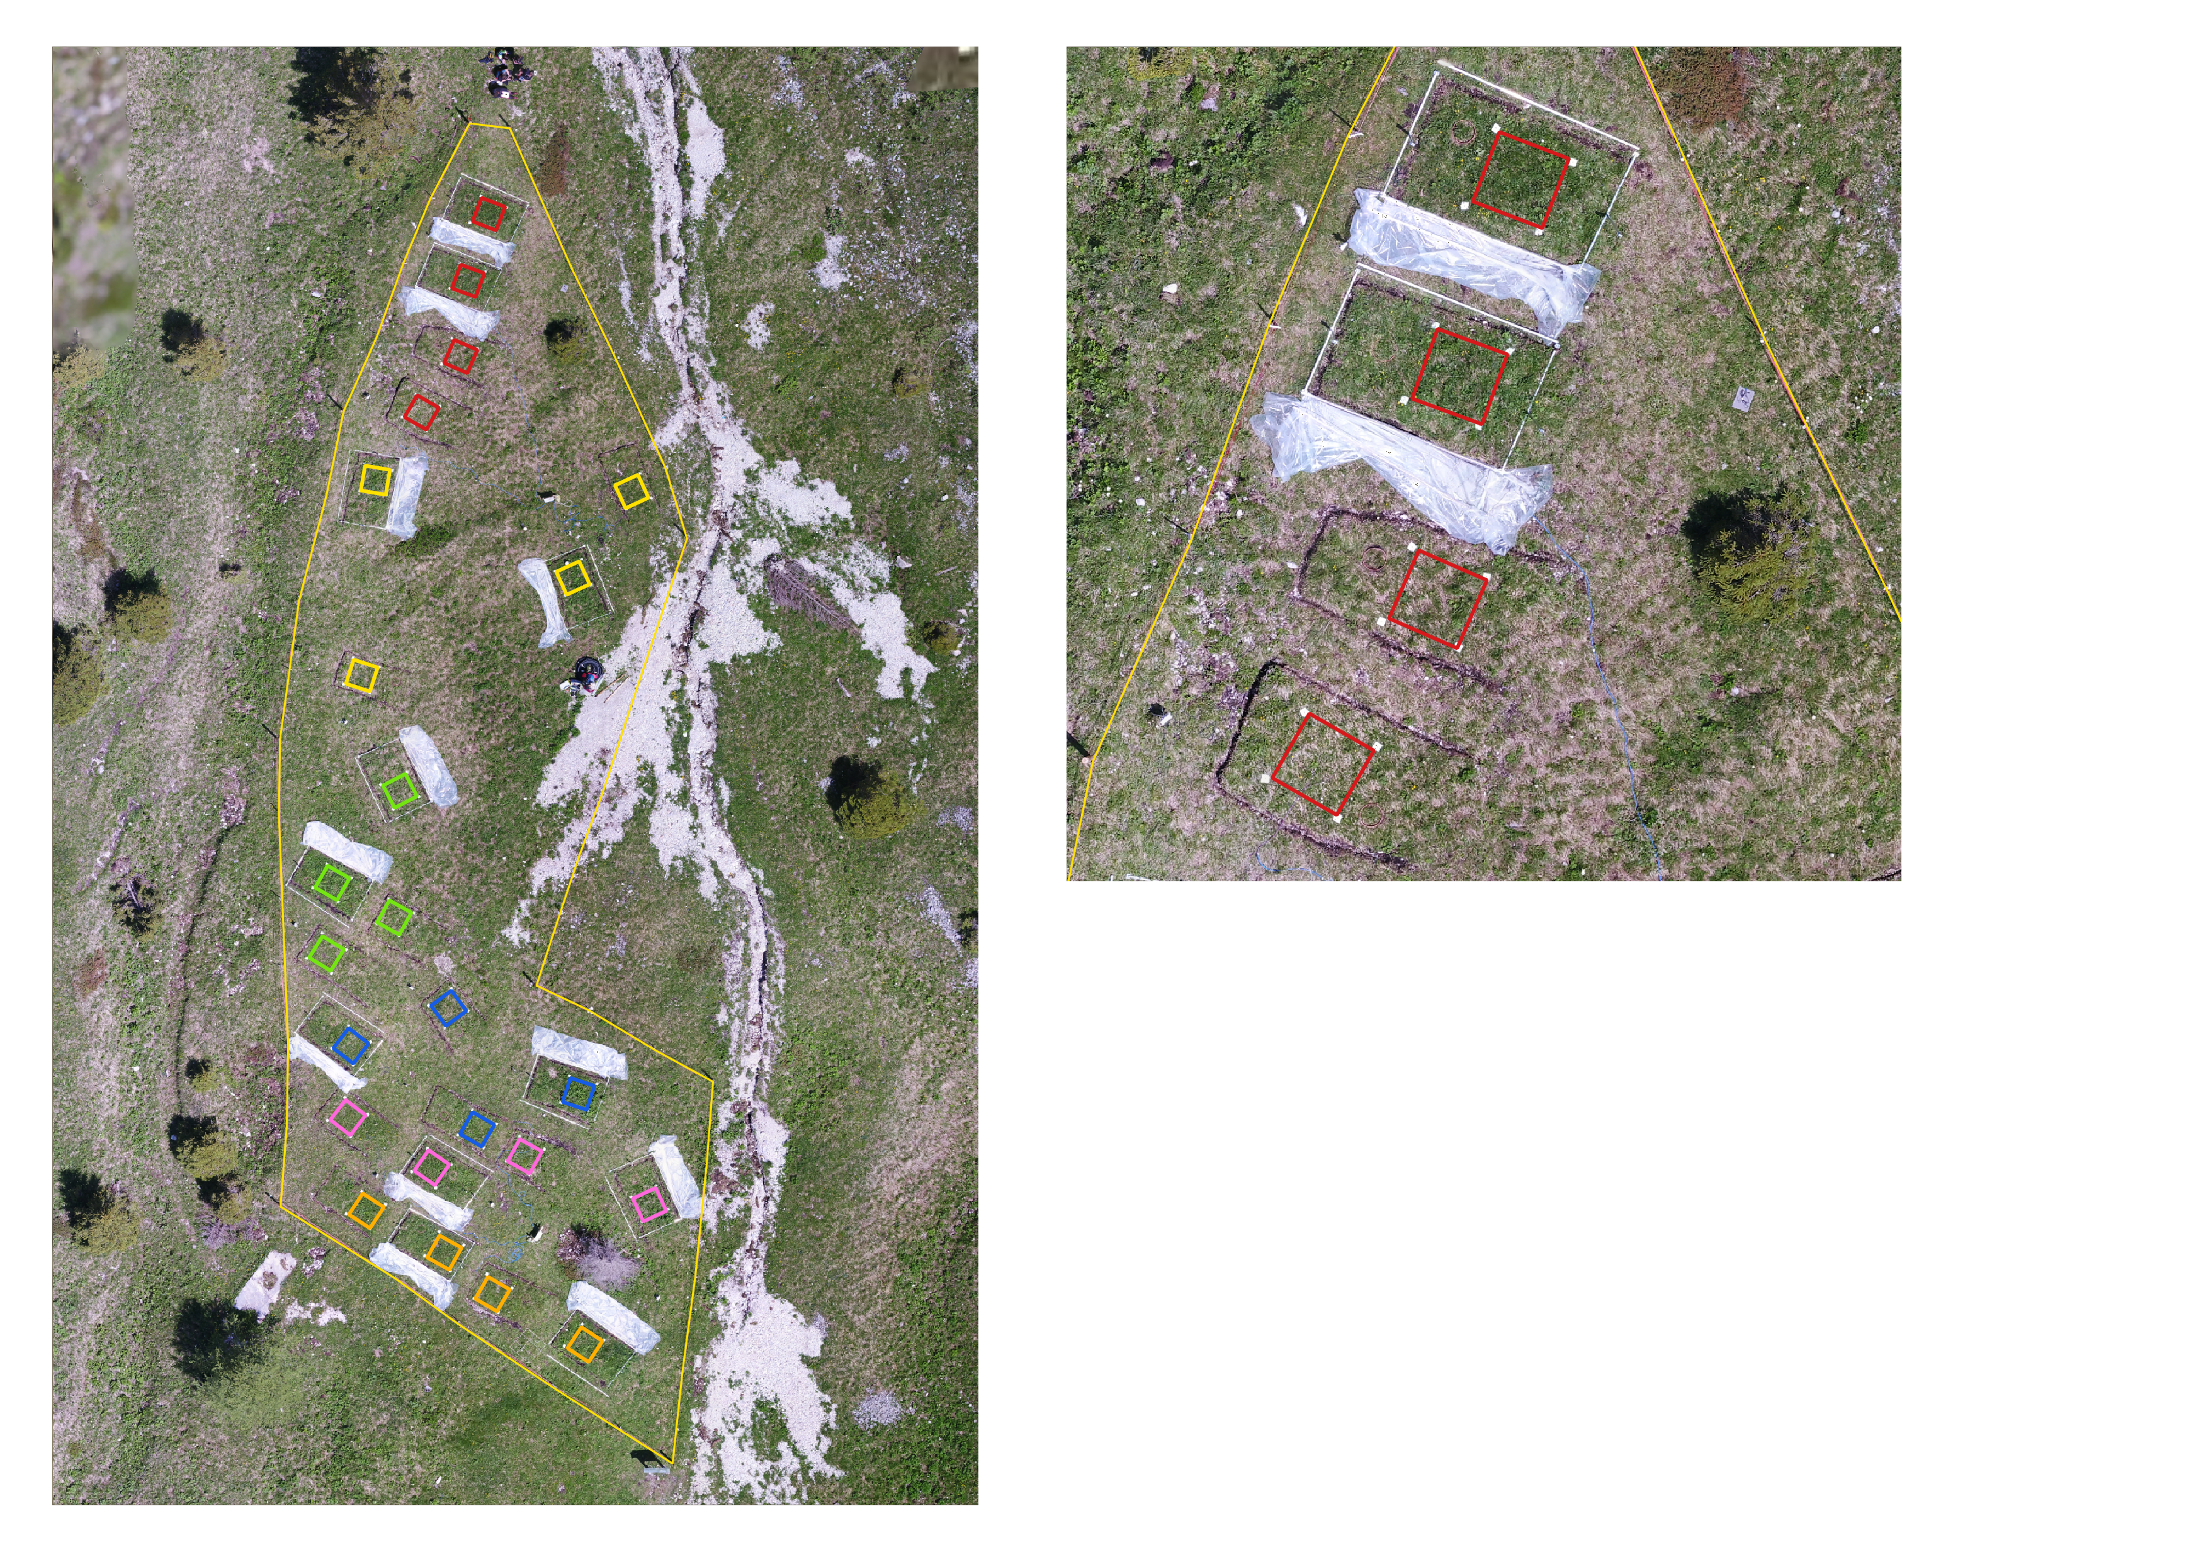
STUDY AREA
W
E
C
Blocks
L
1
heat waves for Whole growing season
heat waves for Early growing season
heat waves for Late growing season
no heat waves (Control)
Treatments
Study sites
Gavia Pass:
2600 m a.s.l.
Siliceous substrate
Habitat 6150
Sappada:
2000 m a.s.l.
Calcareous substrate
Habitat 6170
2
W:
{
3
4
E:
5
L:
C:
6
8th European Congress of Conservation Biology (ECCB)

Slide 9
STUDY AREA
W
E
C
Blocks
L
1
heat waves for Whole growing season
heat waves for Early growing season
heat waves for Late growing season
no heat waves (Control)
Treatments
Study sites
Gavia Pass:
2600 m a.s.l.
Siliceous substrate
Habitat 6150
Sappada:
2000 m a.s.l.
Calcareous substrate
Habitat 6170
2
W:
{
3
4
E:
5
L:
C:
6
8th European Congress of Conservation Biology (ECCB)

Slide 10
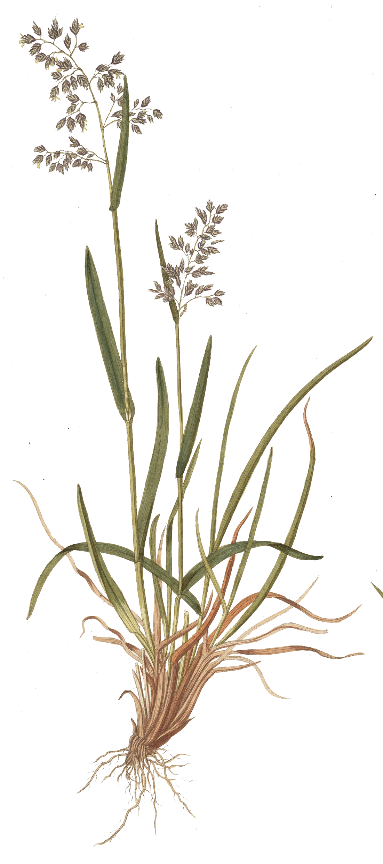
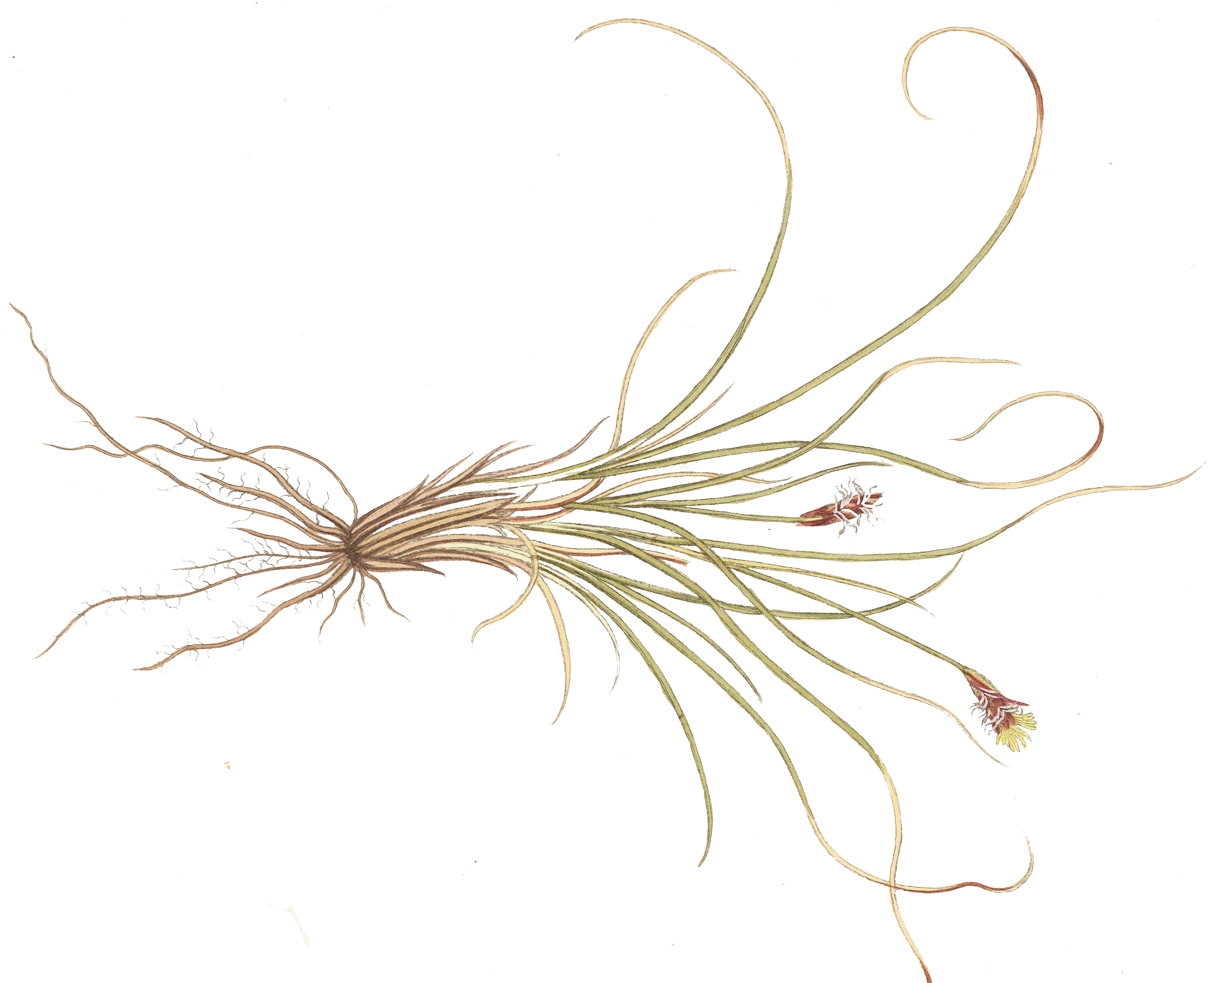
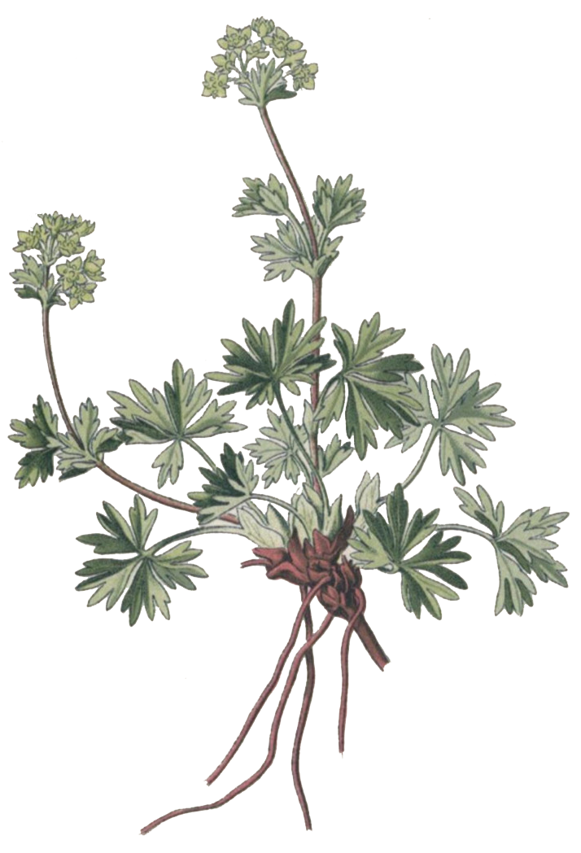
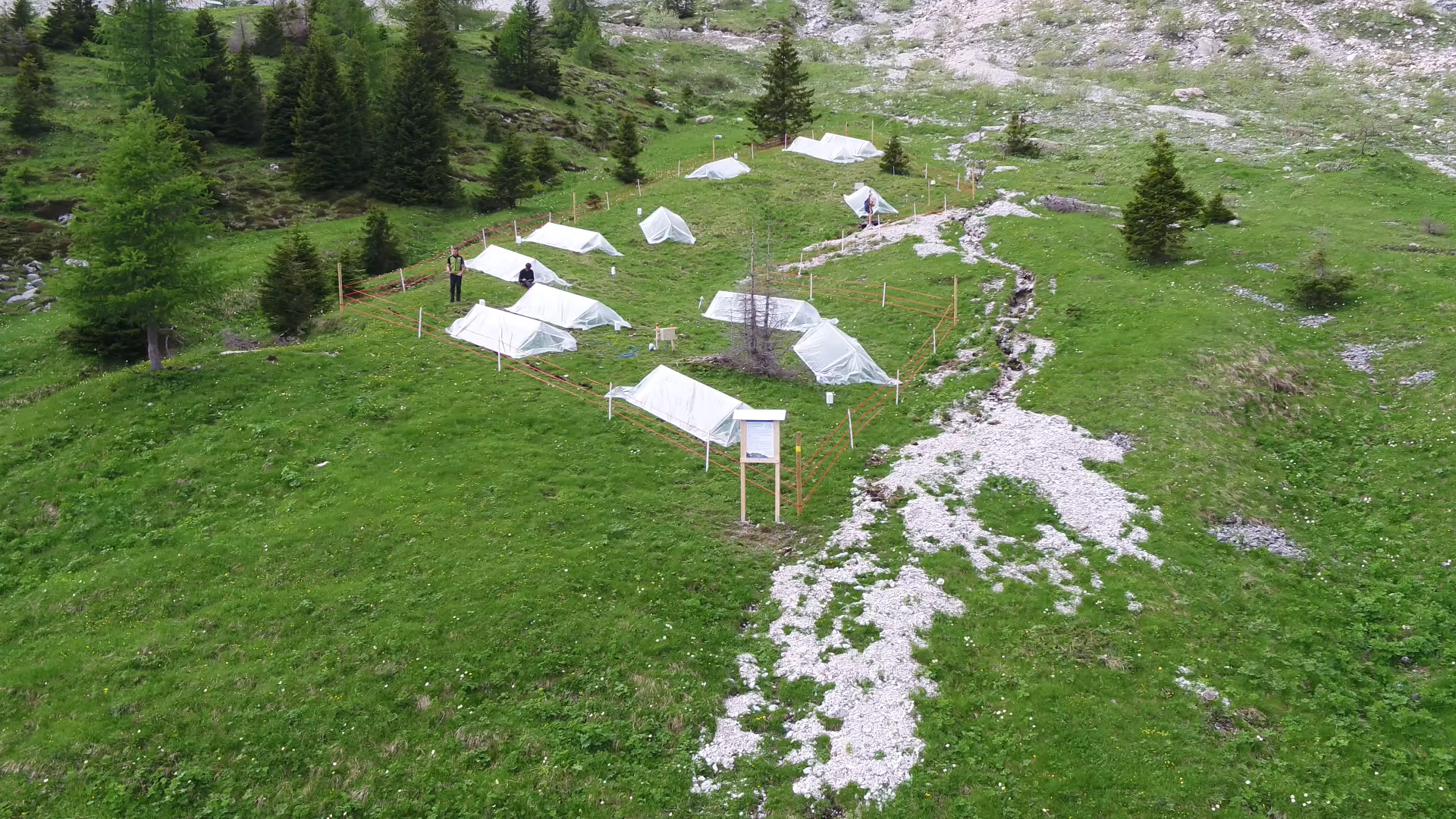
EXPERIMENTAL DESIGN
Whole
Control
Early
Late
T₀
T_{I}
T_{II}
Time
28 days
28 days
8th European Congress of Conservation Biology (ECCB)

Slide 11
SAMPLING
sedge
forb
grass
whole plant community
Carex curvula
Carex ornithopoda
Alchemilla pentaphyllea
Homogyne alpina
Poa alpina
Sesleria caerulea
pigment concentration (chlorophyll, carotenoid)
flavonoid concentration
multispectral survey (UAV + close range)
T₀
T_{I}
T_{II}
8th European Congress of Conservation Biology (ECCB)

Slide 12
SAMPLING
sedge
forb
grass
whole plant community
Carex curvula
Carex ornithopoda
Alchemilla pentaphyllea
Homogyne alpina
Poa alpina
Sesleria caerulea
pigment concentration (chlorophyll, carotenoid)
flavonoid concentration
multispectral survey (UAV + close range)
T₀
T_{I}
T_{II}
8th European Congress of Conservation Biology (ECCB)

Slide 13
SAMPLING
sedge
forb
grass
whole plant community
Carex curvula
Carex ornithopoda
Alchemilla pentaphyllea
Homogyne alpina
Poa alpina
Sesleria caerulea
pigment concentration (chlorophyll, carotenoid)
flavonoid concentration
morphological traits (SLA, DMC, stomata density)
root non structural carbohydrate concentration
multispectral survey (UAV + close range)
biomass (necromass, biomass)
intercept point vegetation survey
T₀
T_{I}
T_{II}
Time
8th European Congress of Conservation Biology (ECCB)

Slide 14
SAMPLING
sedge
forb
grass
whole plant community
Carex curvula
Carex ornithopoda
Alchemilla pentaphyllea
Homogyne alpina
Poa alpina
Sesleria caerulea
pigment concentration (chlorophyll, carotenoid)
flavonoid concentration
morphological traits (SLA, DMC, stomata density)
root non structural carbohydrate concentration
multispectral survey (UAV + close range)
biomass (necromass, biomass)
intercept point vegetation survey
T₀
T_{I}
T_{II}
Time
8th European Congress of Conservation Biology (ECCB)

Slide 15
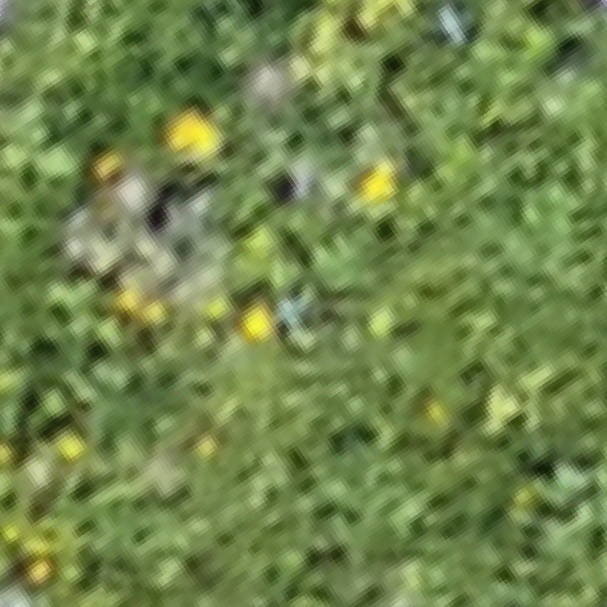
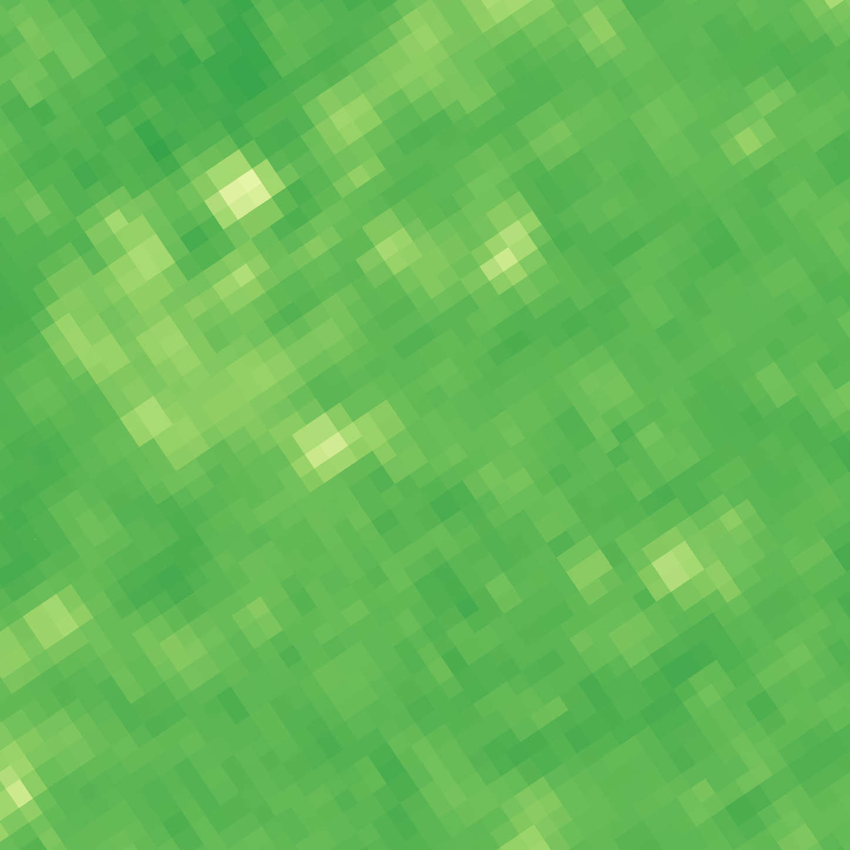
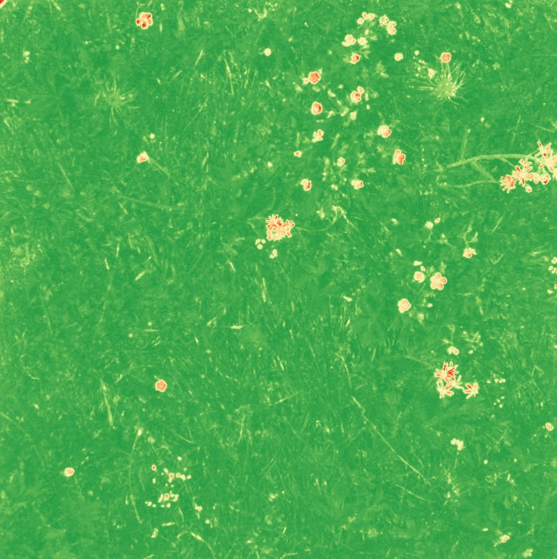
STATISTICAL ANALYSIS
Two datasets (Siliceous and Calcareous) - Linear mixed models
T_{II}
Morphological traits ~ Treatment * Functional groups
Pigments and biochemical analysis ~ Treatment * Functional groups
Biomass production ~ Treatment
RGB
NDVI
UAV
T_{I} - T_{II}
Multispectral survey ~ Treatment * Time
Close range
8th European Congress of Conservation Biology (ECCB)

Slide 16
STATISTICAL ANALYSIS
Two datasets (Siliceous and Calcareous) - Linear mixed models
T_{II}
Morphological traits ~ Treatment * Functional groups
Pigments and biochemical analysis ~ Treatment * Functional groups
Biomass production ~ Treatment
RGB
NDVI
UAV
T_{I} - T_{II}
Multispectral survey ~ Treatment * Time
Close range
8th European Congress of Conservation Biology (ECCB)

Slide 17
STATISTICAL ANALYSIS
Two datasets (Siliceous and Calcareous) - Linear mixed models
T_{II}
Morphological traits ~ Treatment * Functional groups
Pigments and biochemical analysis ~ Treatment * Functional groups
Biomass production ~ Treatment
RGB
NDVI
UAV
T_{I} - T_{II}
Multispectral survey ~ Treatment * Time
Close range
8th European Congress of Conservation Biology (ECCB)

Slide 18
STATISTICAL ANALYSIS
Two datasets (Siliceous and Calcareous) - Linear mixed models
T_{II}
Morphological traits ~ Treatment * Functional groups
Pigments and biochemical analysis ~ Treatment * Functional groups
Biomass production ~ Treatment
RGB
NDVI
UAV
T_{I} - T_{II}
Multispectral survey ~ Treatment * Time
Close range
8th European Congress of Conservation Biology (ECCB)

Slide 19
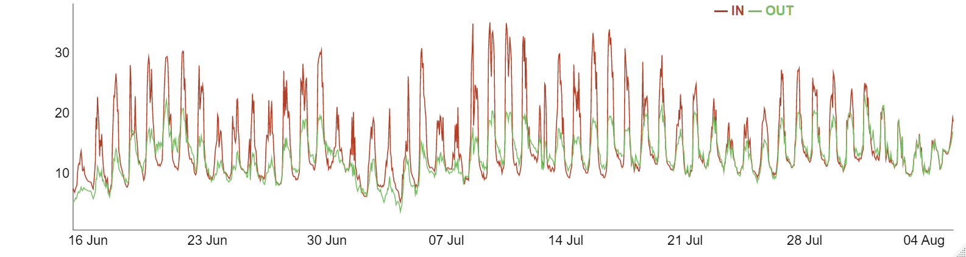
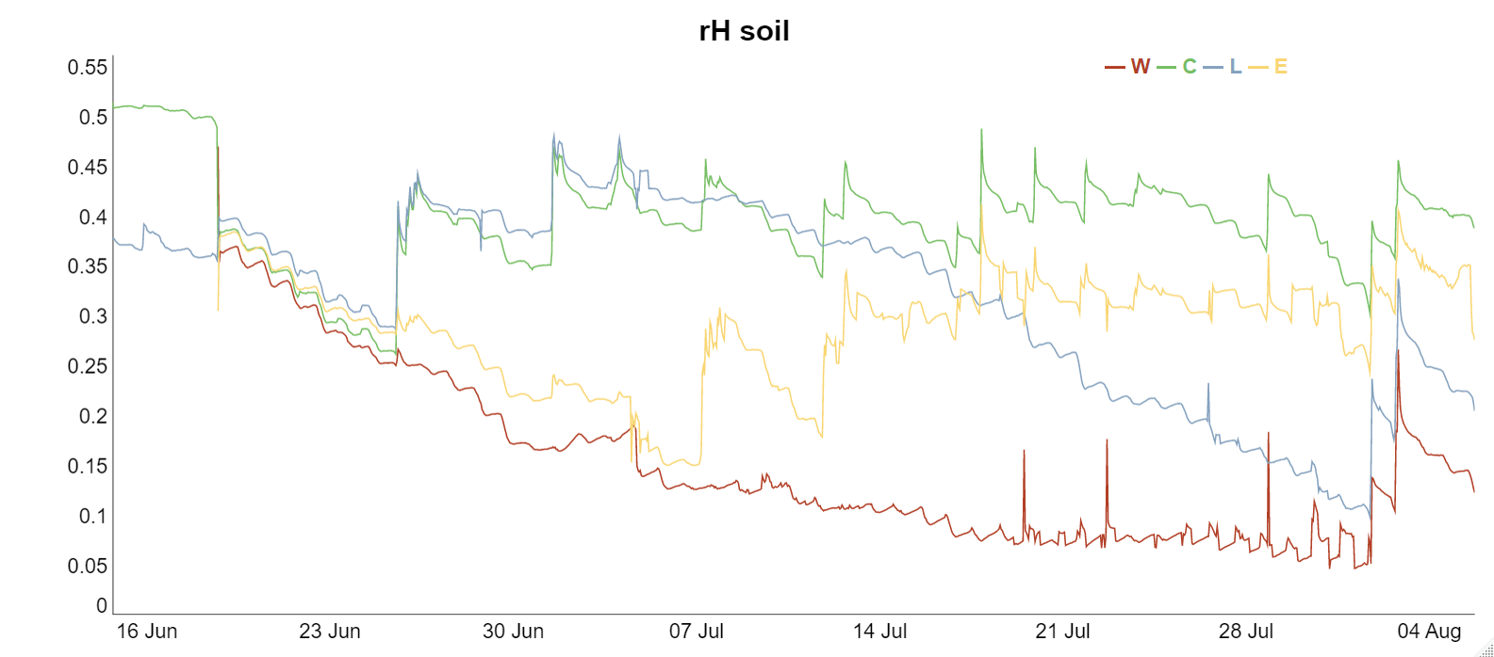
RESULTS
30
20
under the shelter
Air temperature (°C)
outside
10
16/06
23/06
30/06
07/07
14/07
21/07
28/07
04/08
0.5
0.4
whole
control
0.3
late
Soil humidity (°C)
0.2
early
0.1
16/06
23/06
30/06
07/07
14/07
21/07
28/07
04/08
8th European Congress of Conservation Biology (ECCB)

Slide 20
RESULTS
30
20
under the shelter
Air temperature (°C)
outside
10
16/06
23/06
30/06
07/07
14/07
21/07
28/07
04/08
0.5
0.4
whole
control
0.3
late
Soil humidity (%)
0.2
early
0.1
16/06
23/06
30/06
07/07
14/07
21/07
28/07
04/08
8th European Congress of Conservation Biology (ECCB)

Slide 21
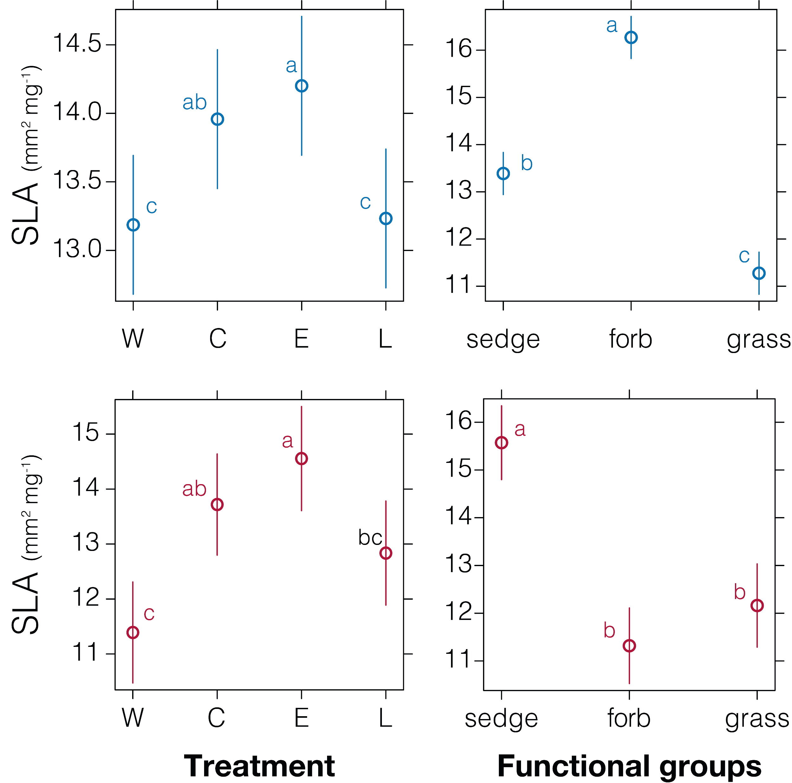
RESULTS
Dependent variable | Substrate type | Factor | P-value
Specific Leaf Area | Siliceous | Treatment | < 0.001 ***
 |  | Functional groups | < 0.001 ***
 | Calcareous | Treatment | 0.004 ***
 |  | Functional groups | < 0.001 ***
Dry matter content | Siliceous | Treatment | < 0.001 ***
 |  | Functional groups | < 0.001 ***
 | Calcareous | Treatment | 0.756
 |  | Functional groups | < 0.001 ***
 |  | Treat. * Funct. groups | 0.041 *
Stomata density | Siliceous | Treatment | 0.043 *
 |  | Functional groups | < 0.001 ***
 | Calcareous | Treatment | 0.527
 |  | Functional groups | < 0.001 ***
8th European Congress of Conservation Biology (ECCB)

Slide 22
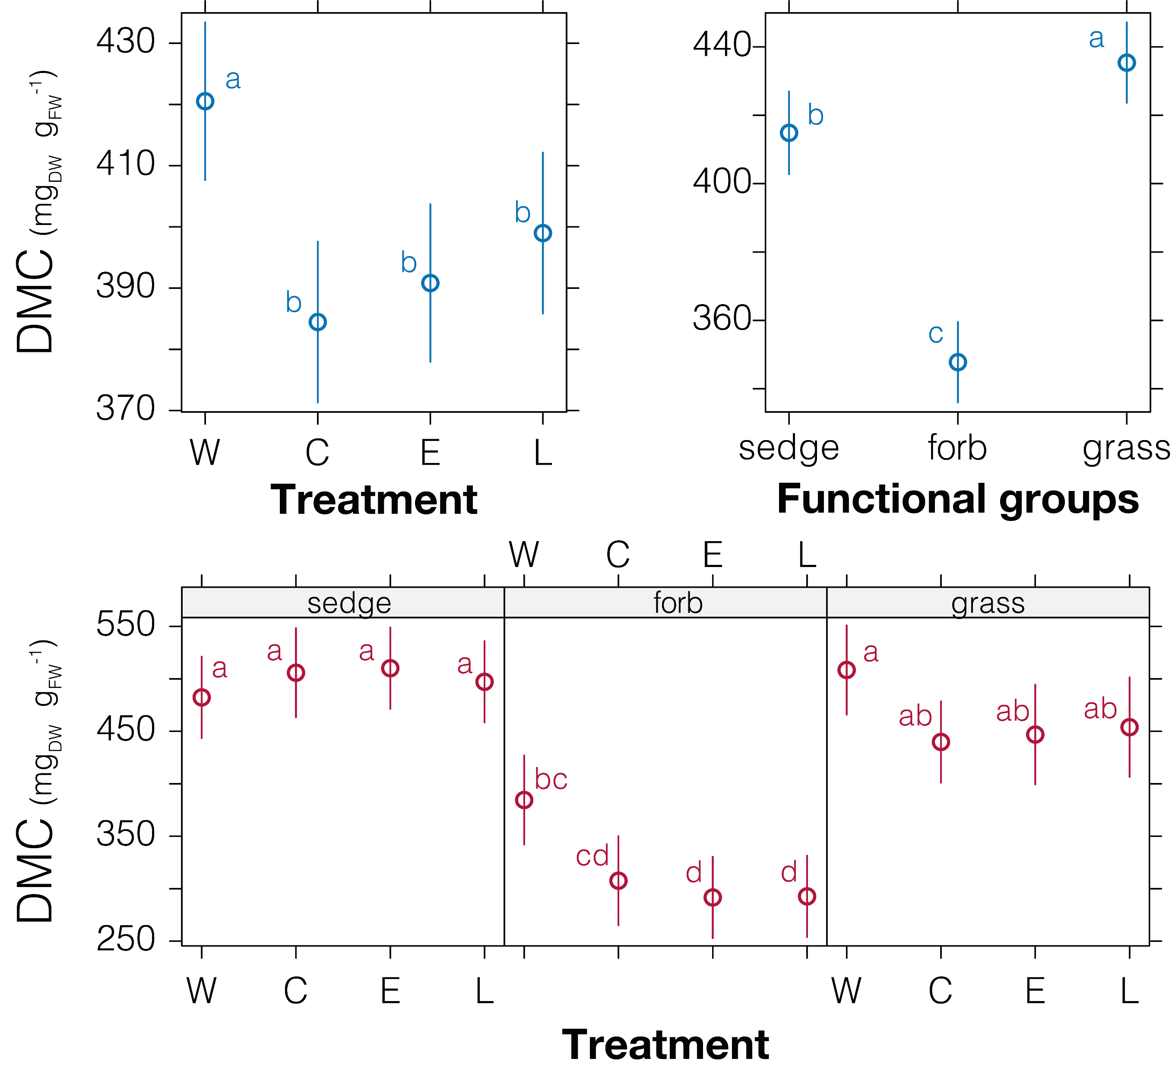
RESULTS
Dependent variable | Substrate type | Factor | P-value
Specific Leaf Area | Siliceous | Treatment | < 0.001 ***
 |  | Functional groups | < 0.001 ***
 | Calcareous | Treatment | 0.004 ***
 |  | Functional groups | < 0.001 ***
Dry matter content | Siliceous | Treatment | < 0.001 ***
 |  | Functional groups | < 0.001 ***
 | Calcareous | Treatment | 0.756
 |  | Functional groups | < 0.001 ***
 |  | Treat. * Funct. groups | 0.041 *
Stomata density | Siliceous | Treatment | 0.043 *
 |  | Functional groups | < 0.001 ***
 | Calcareous | Treatment | 0.527
 |  | Functional groups | < 0.001 ***
8th European Congress of Conservation Biology (ECCB)

Slide 23
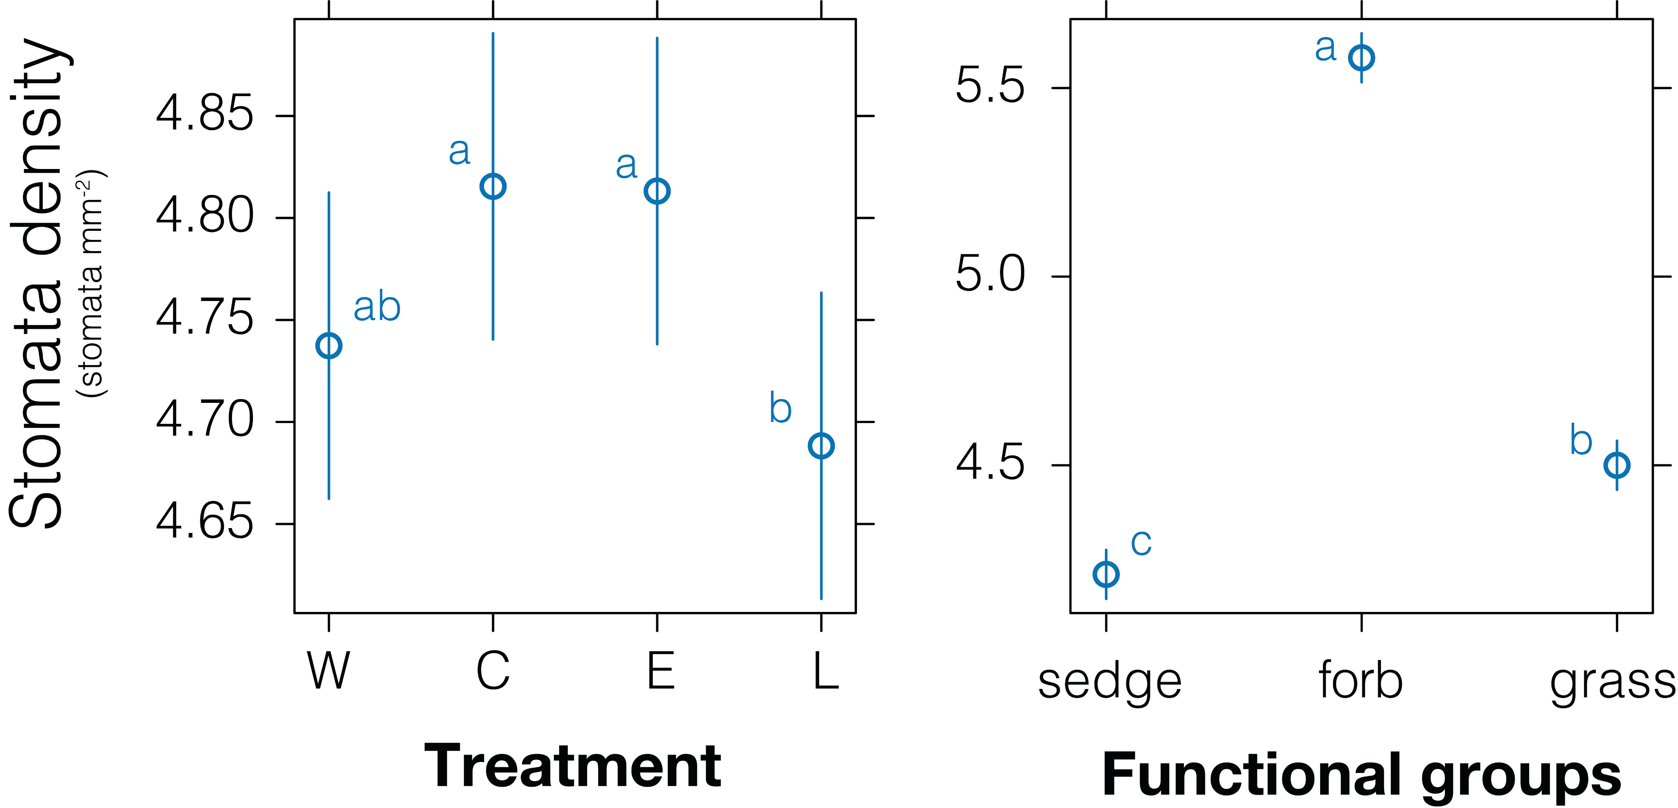
RESULTS
Dependent variable | Substrate type | Factor | P-value
Specific Leaf Area | Siliceous | Treatment | < 0.001 ***
 |  | Functional groups | < 0.001 ***
 | Calcareous | Treatment | 0.004 ***
 |  | Functional groups | < 0.001 ***
Dry matter content | Siliceous | Treatment | < 0.001 ***
 |  | Functional groups | < 0.001 ***
 | Calcareous | Treatment | 0.756
 |  | Functional groups | < 0.001 ***
 |  | Treat. * Funct. groups | 0.041 *
Stomata density | Siliceous | Treatment | 0.043 *
 |  | Functional groups | < 0.001 ***
 | Calcareous | Treatment | 0.527
 |  | Functional groups | < 0.001 ***
8th European Congress of Conservation Biology (ECCB)

Slide 24
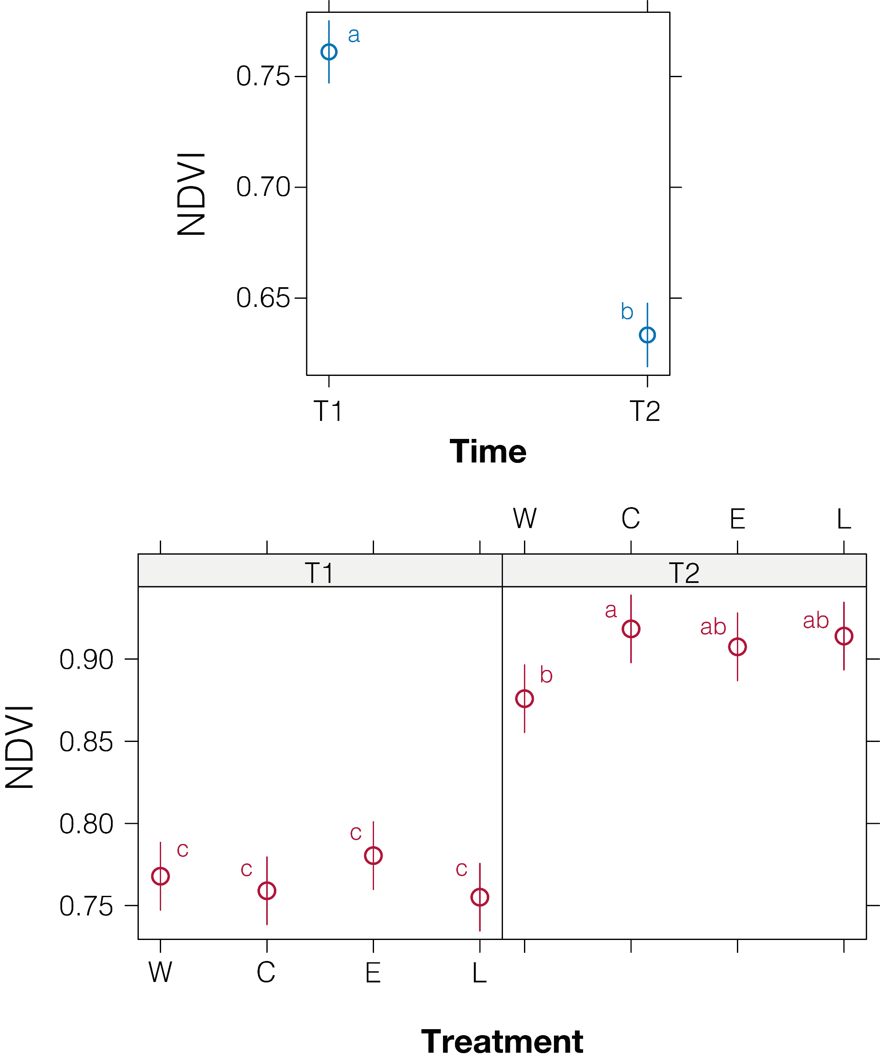
RESULTS
Dependent variable | Substrate type | Factor | P-value
NDVI – UAV | Siliceous | Time | < 0.001 ***
 |  | Treatment | 0.318
 | Calcareous | Time | 0.221
 |  | Treatment | < 0.001 ***
 |  | Time*Treatment | 0.011 *
NDVI – close range | Siliceous | Time | < 0.001 ***
 |  | Treatment | < 0.001 ***
 | Calcareous | Time | 0.235
 |  | Treatment | < 0.001 ***
 |  | Time*Treatment | < 0.001 ***
8th European Congress of Conservation Biology (ECCB)

Slide 25
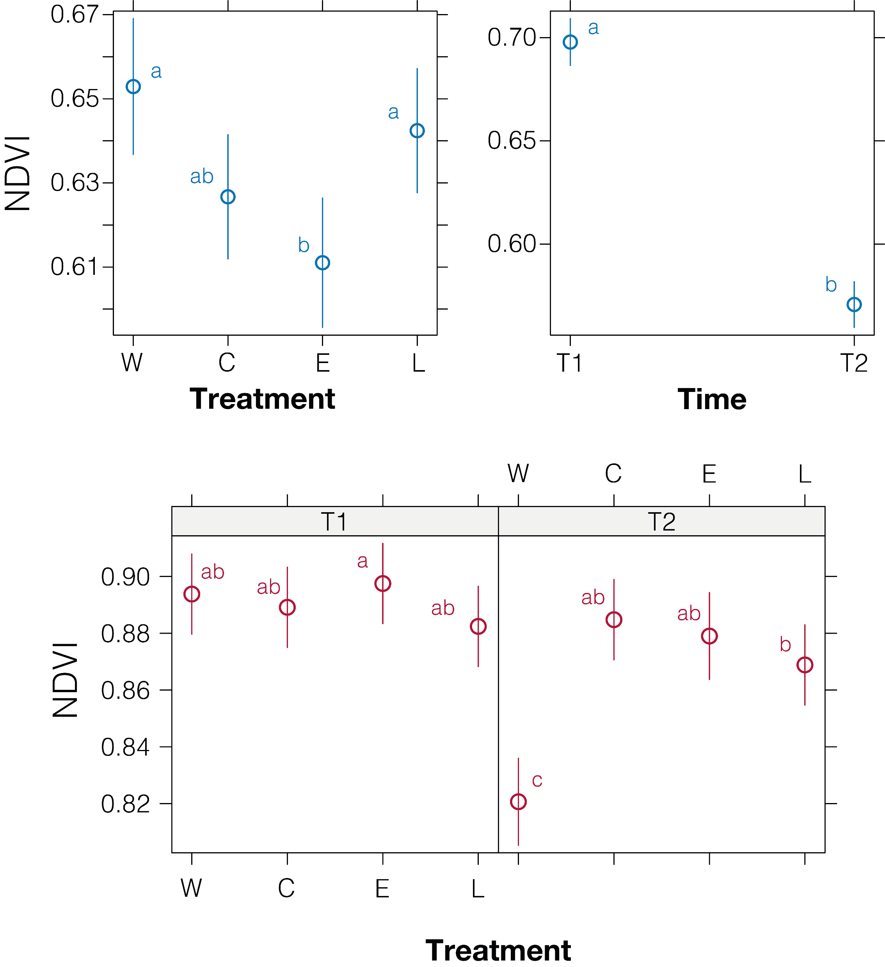
RESULTS
Dependent variable | Substrate type | Factor | P-value
NDVI – UAV | Siliceous | Time | < 0.001 ***
 |  | Treatment | 0.318
 | Calcareous | Time | 0.221
 |  | Treatment | < 0.001 ***
 |  | Time*Treatment | 0.011 *
NDVI – close range | Siliceous | Time | < 0.001 ***
 |  | Treatment | < 0.001 ***
 | Calcareous | Time | 0.235
 |  | Treatment | < 0.001 ***
 |  | Time*Treatment | < 0.001 ***
8th European Congress of Conservation Biology (ECCB)

Slide 26
CONCLUSIONS
RGB
NDVI
UAV
Close range
T₀
T_{I}
T_{II}
Time
28 days
28 days
8th European Congress of Conservation Biology (ECCB)

Slide 27
CONCLUSIONS
RGB
NDVI
UAV
Close range
T₀
T_{I}
T_{II}
Time
28 days
28 days
8th European Congress of Conservation Biology (ECCB)

Slide 28
THANKS
FOR YOUR
ATTENTION
delpino.arianna@spes.uniud.it

