Slide 1



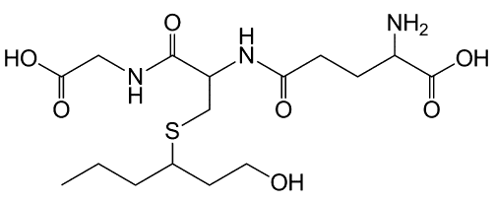
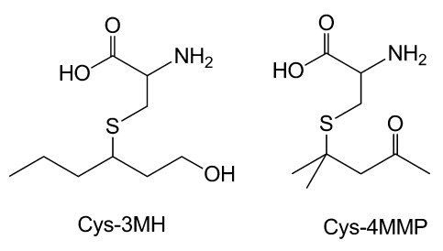
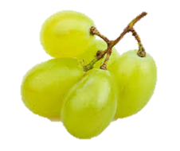
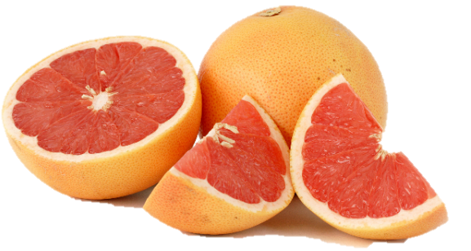
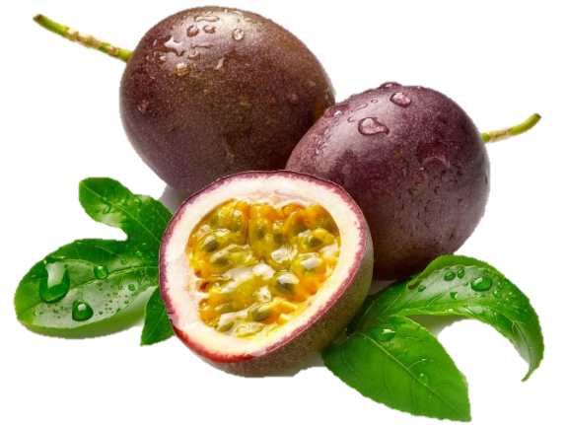
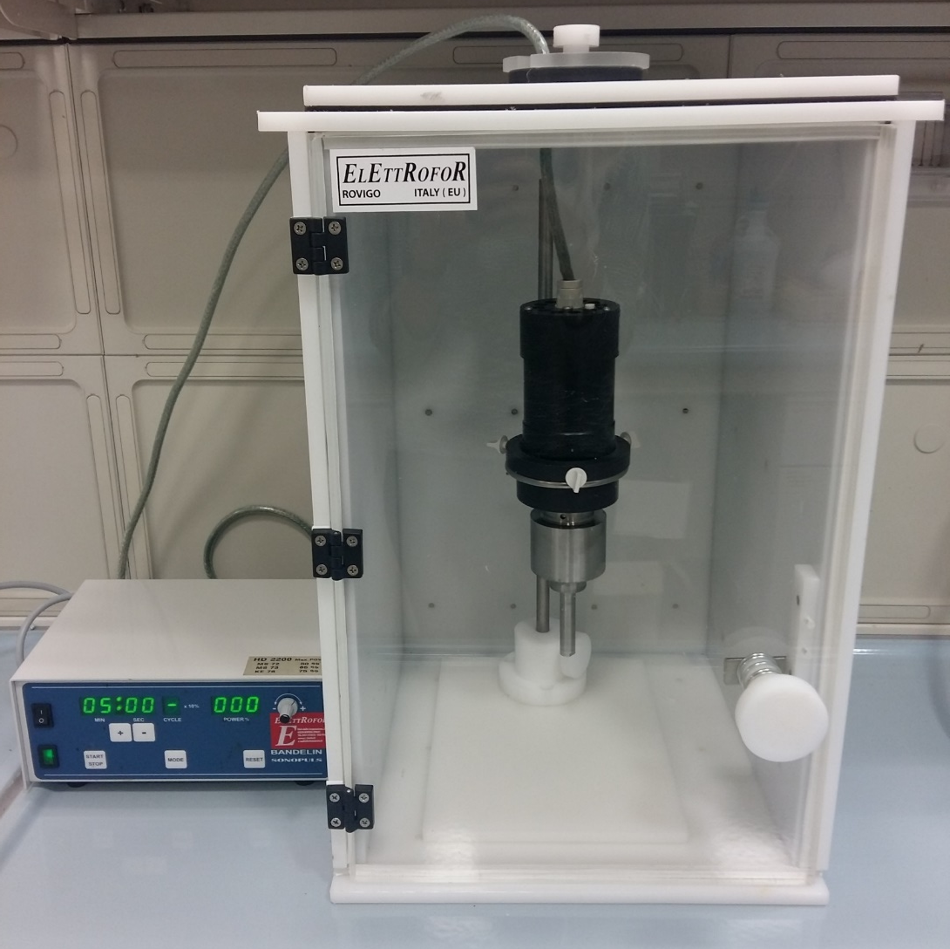
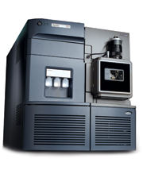
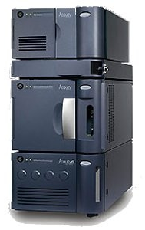
Ultrasounds application during prefermentative maceration to optimize the extraction of aromatic precursors in white grapes
Emilio Celotti¹, Tomas Roman*², Loris Tonidandel², Elisabetta Bellantuono¹, Laura Barp², Roberto Larcher², Raffaele Guzzon² and Giorgio Nicolini².
¹Department of Agricultural, Food, Environmental and Animal Sciences, Section of Alcoholic Beverages. University of Udine, Via Sondrio 8, 33100, Udine, Italy.
²Fondazione Edmund Mach. Centro di Trasferimento Tecnologico. Via Mach 1. 38010. San Michele all’Adige (TN) Italy.
tomas.roman@fmach.it
INTRODUCTION
Ultrasounds are used in the food industry in many different areas as an aiding technology for homogenization, degasation, crystallization, meat tenderization, filtration, extraction or sanitization. Thanks to the formation of bubbles and their violent collapse, in a liquid media it can be created zones with extremely high temperature and pressure that can either accelerate the kinetic of chemical and enzymatic reactions or facilitate the mechanical breakage of the cellular walls. These mechanisms have been already exploited in winemaking applied research for the extraction of phenolic compounds during alcoholic fermentation or the lysis of yeast lees in order to improve filtration yields of wine. However, little is known about the effect of ultrasounds applied in grape mash for the extraction of compounds responsible of the aroma of wines.
Thiols
Varietal thiols are compounds responsible of tropical and fruity scents that characterize the aroma of some wines, with tropical (notes?) scents. 3-mercaptohexan-1-ol and its acetated are formed during alcoholic fermentation mainly from the liberation and subsequent acetylation of non volatile precursors linked to Glutathion (GSH-3MH) and Cystein (Cys-3MH)
GSH-3MH
Lab scale experiment
Five white grape batches manually destemmed, maintaining intact pedicels
Cys-3MH
Homogeneisation and suddivision in lots
Grape crushing
Ultrasound treatment
Control
Main quality control parameters of grapes
Ultrasound treatment:
5 min - 20 kHz - 153 μm
Sample | Brix (°) | Reducing sugars (g/L) | pH | Titartrable acidity (g/L) | Tartaric acid (g/L) | Malic acid (g/l) | Potasium (g/L) | FAN (mg/l)
A | 23,7 | 245 | 3,62 | 3,0 | 6,23 | 1,21 | 2,04 | 105
B | 23,5 | 242 | 3,62 | 3,1 | 6,07 | 1,57 | 2,00 | 102
C | 23,0 | 236 | 3,55 | 3,4 | 5,91 | 1,68 | 1,85 | 133
D | 23,1 | 238 | 3,48 | 3,9 | 6,01 | 1,75 | 1,85 | 109
E | 22,8 | 235 | 3,39 | 4,0 | 5,97 | 1,80 | 1,68 | 106
Total polyphenols
(mg/L)
Catechins
(mg/L)
Conductibility
(μS/cm)
UHPLC-MS
Mean concentration of 3-mercaptohexan-1-ol precursors
 | GSH-3MH (μg/L) | Cys-3MH (μG/L)
Control | 79.3±17.8 | 93.2±16.8
Treated | 83.3±17.9 | 109.4±16.8
Positive trend, even if mean differences are not statistically significant
Control
Treated
Control
Treated
Control
Treated
CONCLUSIONS
The increase of total polyphenols, catechins and conductivity has confirmed the goodness of the ultrasound treatment on the extraction mechanisms from grape mash. The variability found after treatments on these parameters indicates the possibility of an enologycal mangament of the treatment.
Ultrasound treatment has not statistically augmented the concentration of Cys-3MH or GSH-3MH, however it can be obserbed an positive trend of mean values.
The de novo formation of 3MH precursors is already reported to occur enzymatically during grape and juice manipulation. A further research is necessary in order to depurate results from the effect of Ultrasounds on enzymes involved in deactivation and/or the sonochemical cleavage of these molecules.

